Slide 1
Final Project - Principal component analysis (PCA) on single cell gene expression (scRNAseq) Human Prefrontal Cortex Development Data.
Wayne Chi Wai Ng
Student ID: 12232148
Date: May 21, 2021

Slide 2
Single Cell Gene Expression (scRNAseq) Human Prefrontal Cortex Development Data
The Human Prefrontal Cortex Development Data dataset contains a single cell gene expression matrix with n = 24153 genes and p = 2394 cells.
Each value is in the unit of transcript-per-million (TPM).
The single cells were collected in the human embryonic prefrontal cortex (PFC) from gestational weeks (GW) 8 to 26.
This project is to perform PCA on scRNAseq Human Prefrontal Cortex Development Data.

Slide 3
Challenges
Standard PCA can not handle scRNAseq
scRNAseq data are much noisier than RNAseq data
Need to show different cell lines

Slide 4
R script for pre-filtering on GSE104276
GSE104276_filtered<-GSE104276_filtered[!duplicated(GSE104276_filtered$Gene), ]
rownames(GSE104276_filtered)<-GSE104276_filtered$Gene
GSE104276_filtered<-na.omit(GSE104276_filtered[,-1])
GSE104276_filtered<-GSE104276_filtered[rowSums(GSE104276_filtered)>10,]

Slide 5
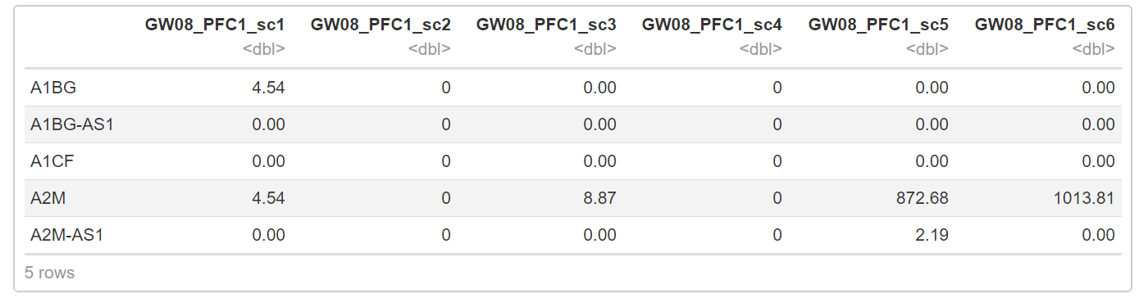
After pre-filter, dimension of GSE104276 has changed to 21368 genes x 2394 cells. Here are top 5 genes x 5 cells after pre-filter:

Slide 6
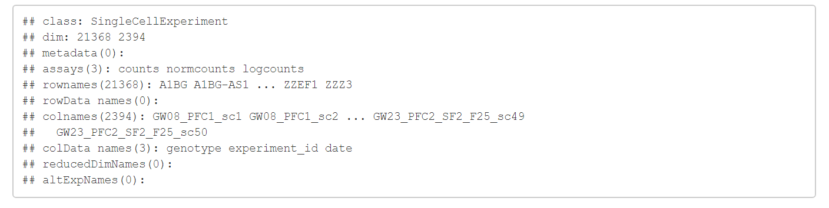
SingleCellExperiment class object created in Bioconductor scRNAseq package

Slide 7
R script for uniform manifold approximation and projection (UMAP) method
# Feature selection.
dec <- modelGeneVar(sce)
hvg <- getTopHVGs(dec, prop=0.1)
# Dimensionality reduction.
set.seed(1234)
sce <- runPCA(sce, ncomponents=25, subset_row=hvg)
sce <- runUMAP(sce, dimred = 'PCA', external_neighbors=TRUE)
# Clustering.
g <- buildSNNGraph(sce, use.dimred = 'PCA')
colLabels(sce) <- factor(igraph::cluster_louvain(g)$membership)
# Visualization.
plotUMAP(sce, colour_by="genotype")

Slide 8
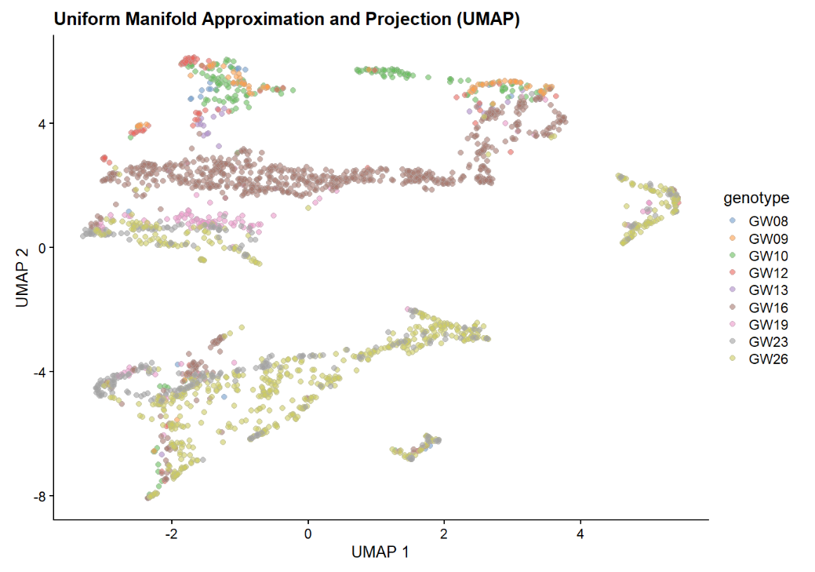
Figure 1 PCA from uniform manifold approximation and projection (UMAP) method

Slide 9
R script for t-Distributed Stochastic Neighbor Embedding (t-SNE) method
set.seed(5252)
tsne_data <- Rtsne(pca_data$x[,1:50], pca = FALSE, check_duplicates = FALSE)
reducedDims(sce) <- list(PCA=pca_data$x, TSNE=tsne_data$Y)
plotTSNE(sce, colour_by="genotype") + ggtitle("Rtsne with low-dimensions")

Slide 10
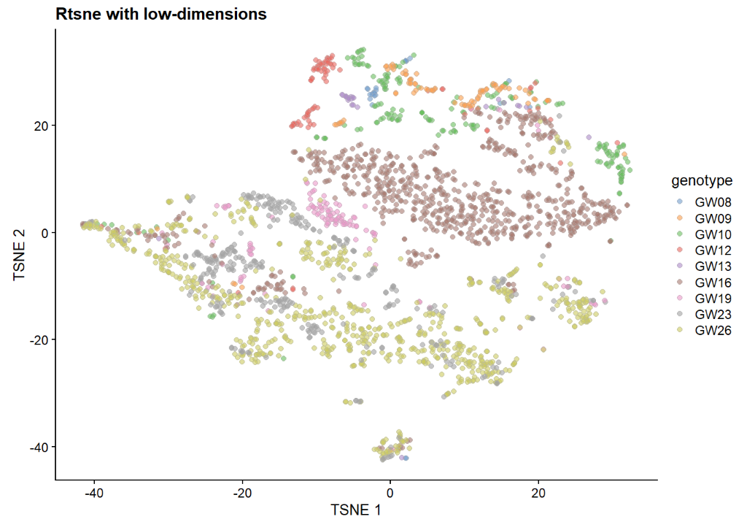
Figure 2 PCA from t-Distributed Stochastic Neighbor Embedding (t-SNE) method

Slide 11
Conclusions
Perform PCA on the Human Prefrontal Cortex Development Data scRNAseq dataset
Different methods are performed: standard PCA, UMP, t-SNE
The t-SNE method provides better cell types separation comparing to UMAP method.

Slide 12
Thank you

